Slide 1
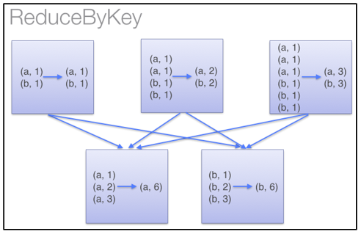
Partition 1
Partition 2
Partition 3

Slide 2
